Slide 1
Mechanics
Can mark windows with eggs which doubles the points for that window smashed.
Power bar and moving arrow for direction
Score
Events to give players extra points
Turn taking
Notes:
Marking a window with eggs will skip a player one turn and has a certain cooldown.
Sometimes , a random person might appear , if the player hit that person with a brick , gets extra points.
Each player has just one tap per turn.

Slide 2
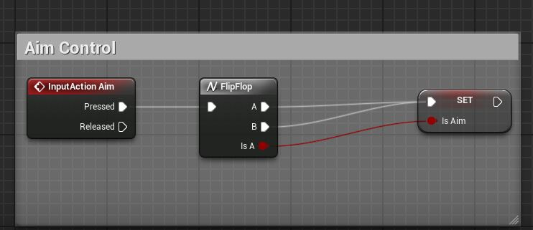
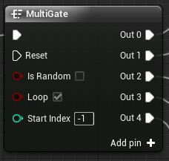
Code
Multi-Gate / Flip Flop
Booleans
Loops
Notes:
When it comes to turn based game , the best thing I could think of is the MultiGate and Flip Flop.
Also Booleans are an important part that will help us reach our objective.
Loops will help us maintaining the same pattern , so it could run again and again until a specific point is reached.

